Slide 1
Temporal Applications for Big Data
Realizing new uses for Big Data
Jonathan Avner, WRA
Greg Giaimo, ODOT

Slide 2
Time and Big Data
1
Traditional data collection has been what we “knew” at a given time.
The temporal nature of big data provides insights into additional time periods:
Before and after studies
Seasonal modeling
Short term forecasts
1500 years ago everybody “knew” that the Earth was the center of the universe. 500 years ago, everybody “knew” that the Earth was flat. And 15 minutes ago, you “knew” that humans were alone on this plant. Imagine what you’ll “know” tomorrow.
- Kay, MiB

Slide 3
Travel Demand Model Application
Hampton Roads Model Development
Use of Big Data for External-External and External-Internal Modeling
Testing of model to a 2017 validation year (calibration to 2015)
Temporal use of big data
Changes in travel patterns on key corridors because of roadway projects impacting validation

Slide 4
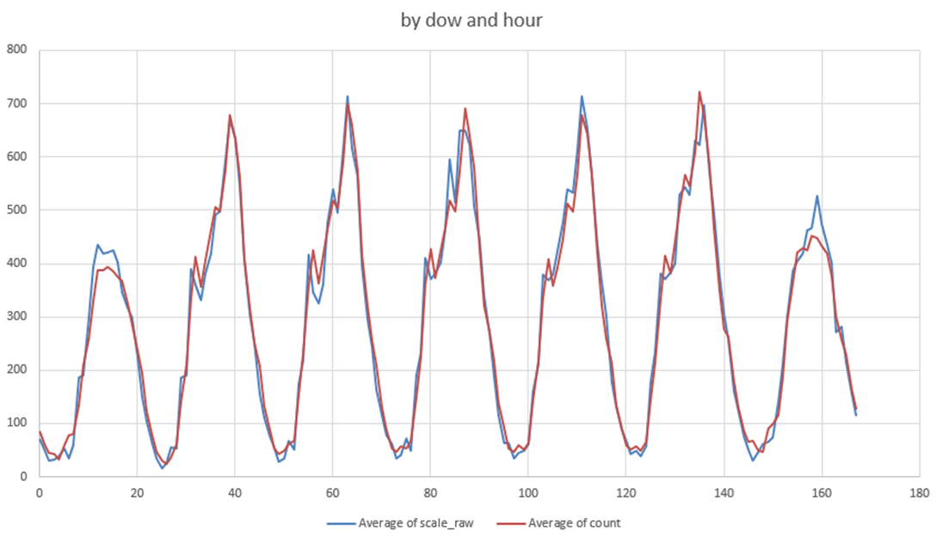
Estimation of Design Hour Traffic
Design hour traffic (30th Hour) required for highway design
Currently estimated based on limited permanent traffic recorders
ODOT worked with Streetlight to test producing location specific data
Permanent traffic count vs Streetlight by hour of the week – averaged across the year

Slide 5
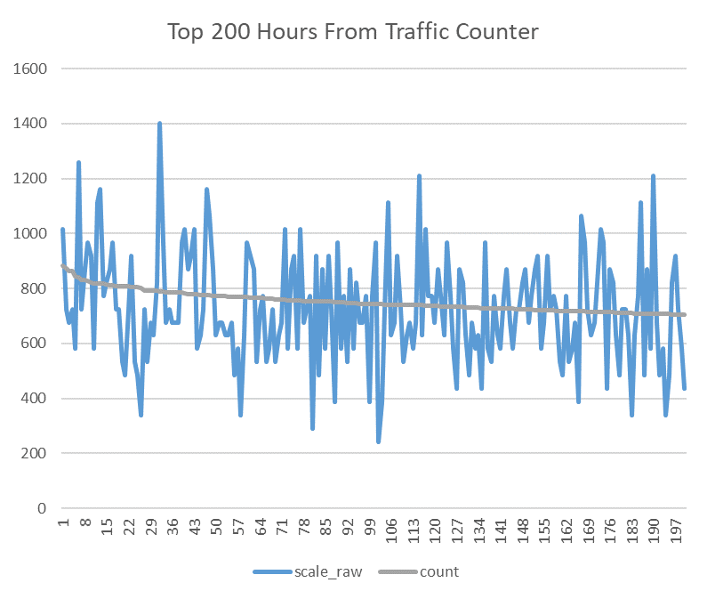
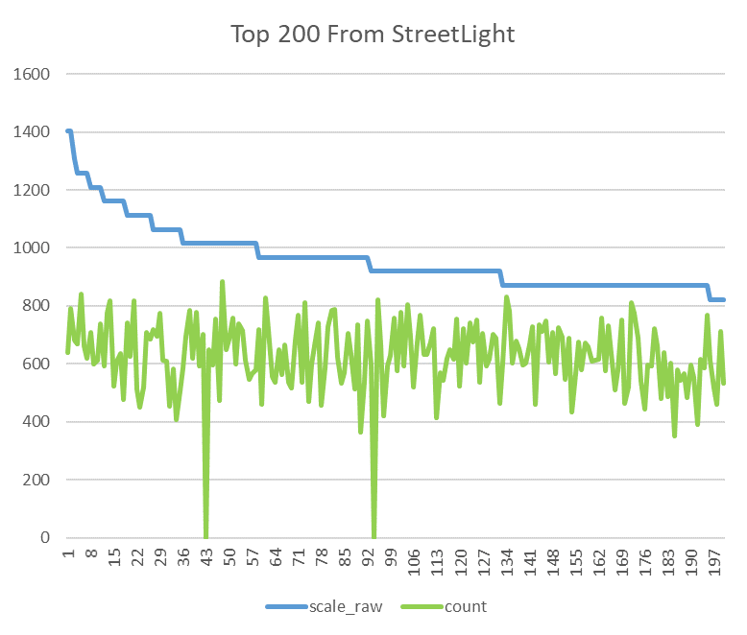
Estimation of Design Hour Traffic
Significant sampling variance: challenge for identifying Nth highest hour
Observations when looking at 200 highest hours
Streetlight is distributed around the count
Sorted by Streetlight highest hours, the count volume is much lower

Slide 6
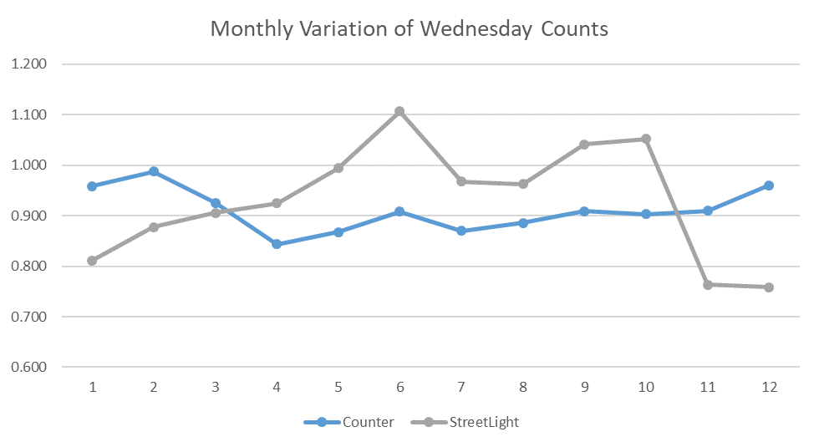
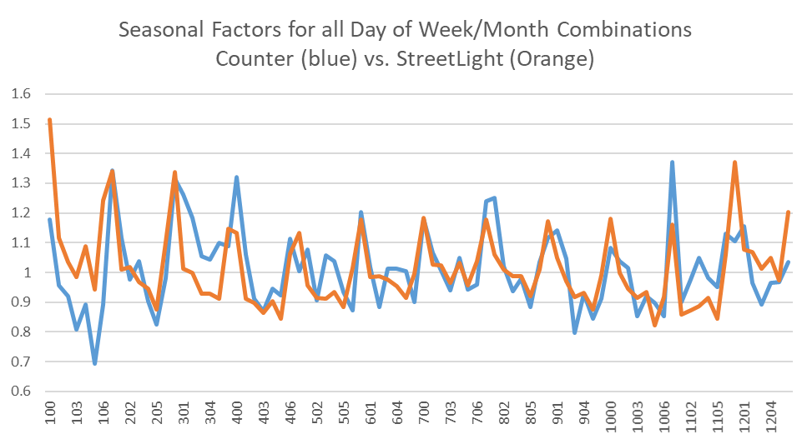
Seasonal / Day of Week AADT Factors
Adjustment of a single or multiple day count to average weekday or season
Typically use the permanent count data
Initial analysis showed significant variation of count vs Streetlight for a given day – linked to adjustment to annual count
Since Streetlight adjusts to monthly sample rate

Slide 7
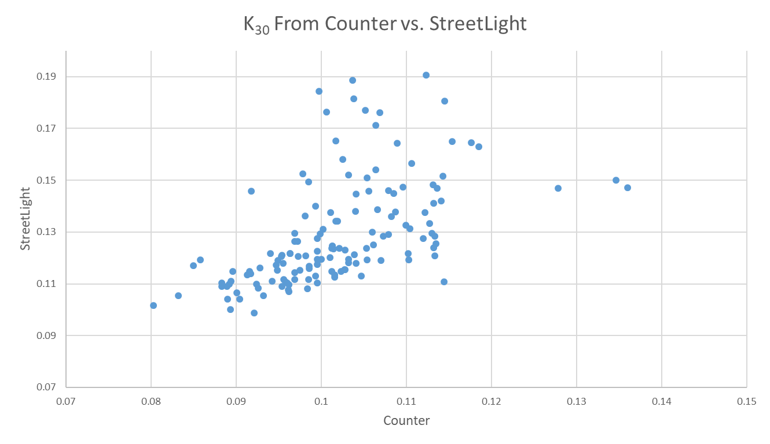
Conclusions
Model Application
Opportunity to expand the predictive horizon of the model
Design Hour Traffic
Streetlight based K30 were about 26% higher
Improvement with greater market penetration
Seasonal / Day of Week AADT
Improved with control to seasonal / monthly totals (part of software)
Jonathan Avner, WRA
javner@wrallp.com
Greg Giaimo, ODOT
Greg.Giaimo@dot.state.oh.us

